Slide 1
Last Week
Make PowerPoint For Friday
Get more pictures of bad prints
What Questions need to come up?
What can we do for the next print? What can they do for the next print? Questions like this need to come up
Build Testing Rig after part delivery
Hopefully meeting leads to work (Fri 9:15am)
Embrace variety around the two chamber model. Larger filets and rounds. Donuts instead of burgers. 4 chambers . 6 chambers but small. Brat size instead of white claw size. Get varieties of each
Helix with offset chamber and more space between layers
Hexagonal/Octagonal helix
Review assembling and animating a 4 bar mechanism connected by revolute or prismatic joints

Slide 2
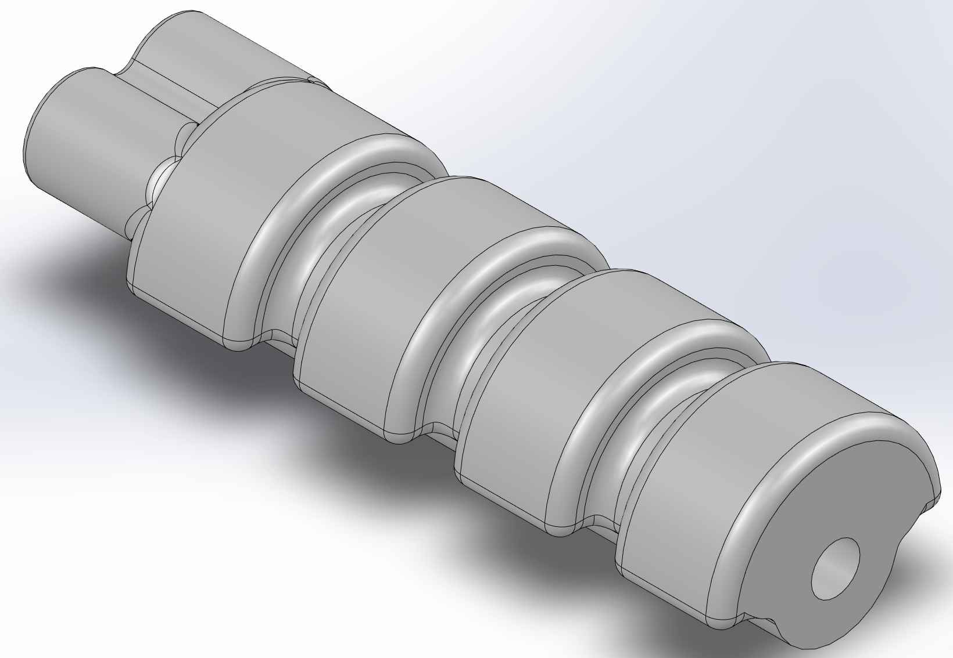
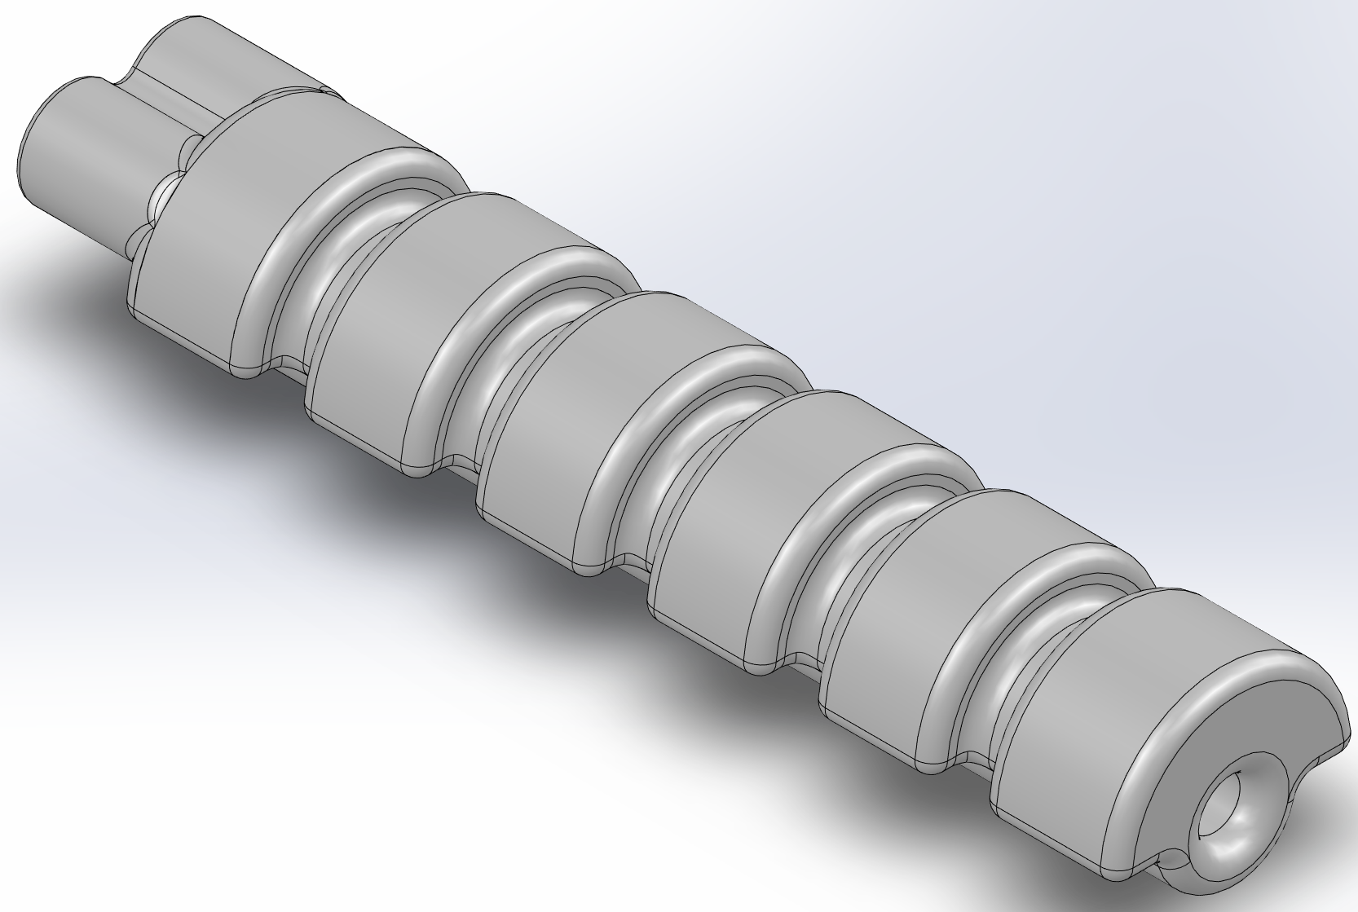
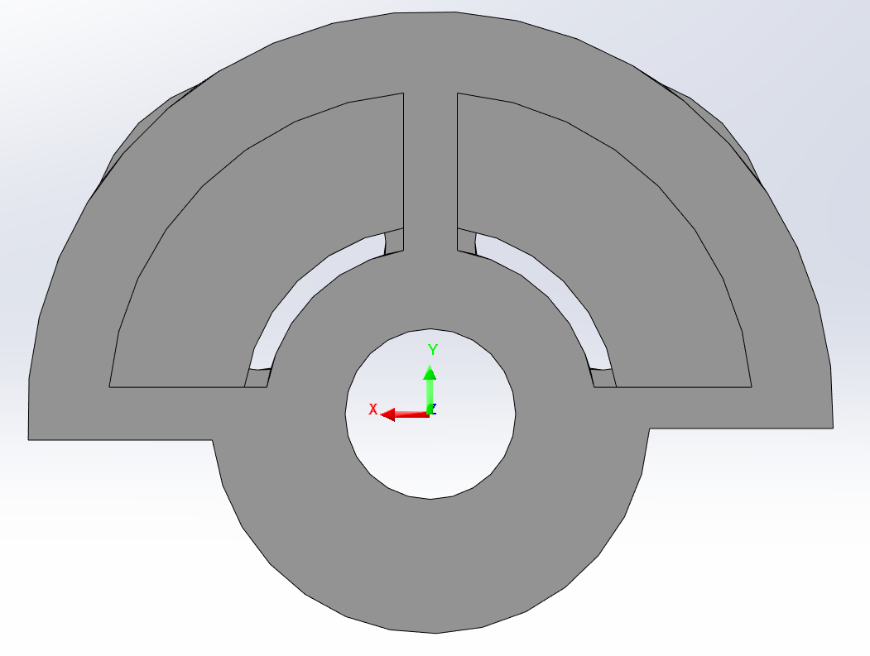
Highlighter design

Slide 3
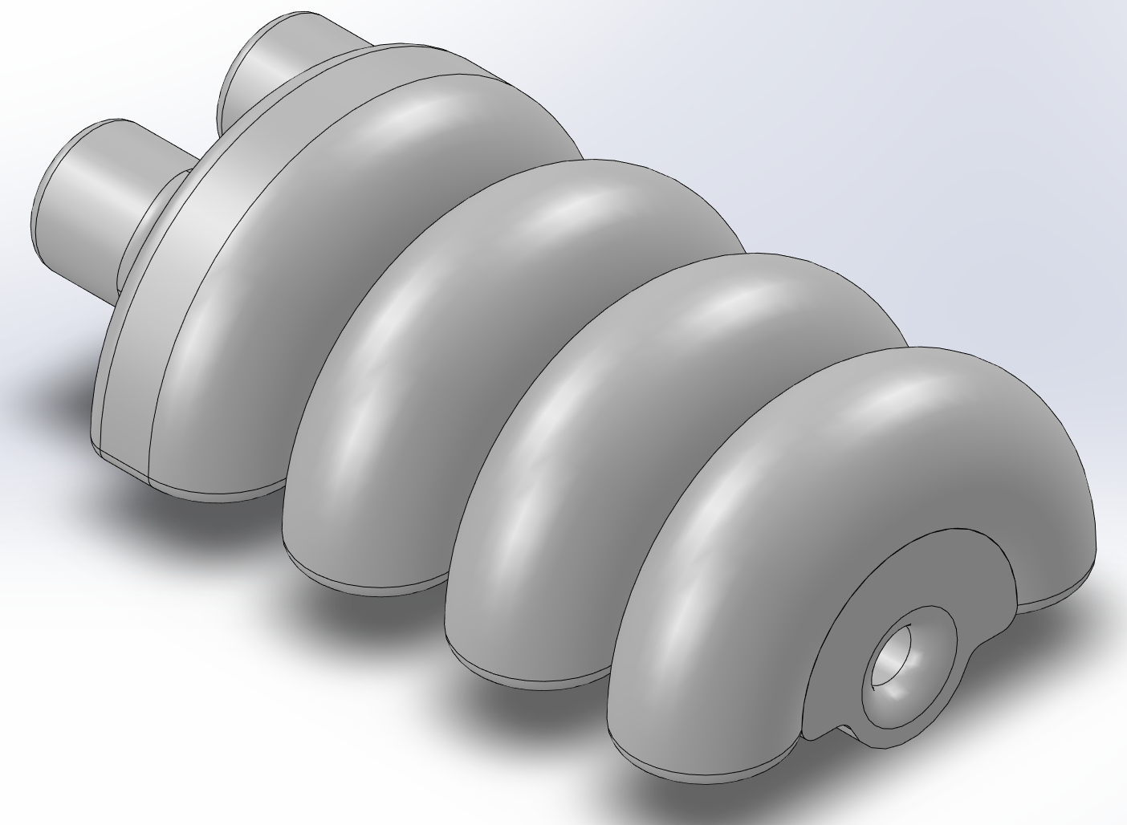
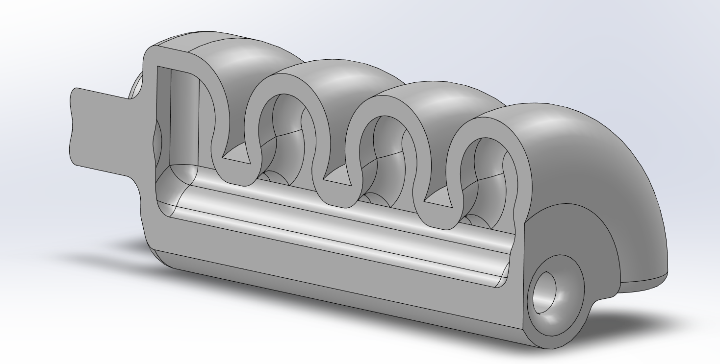
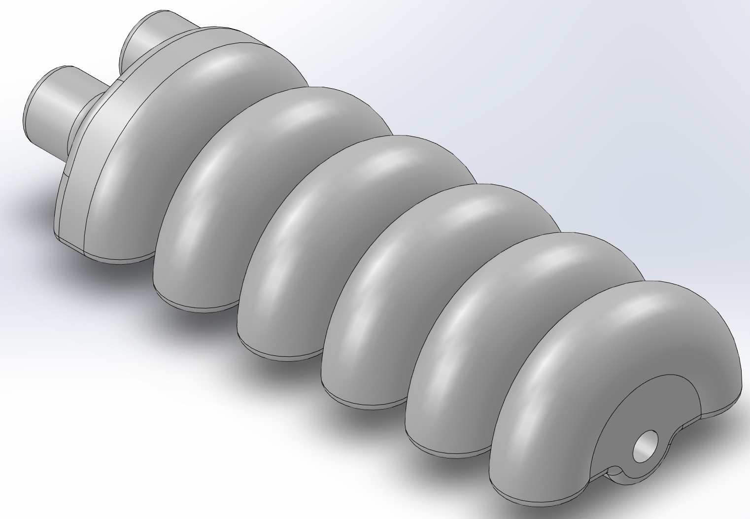
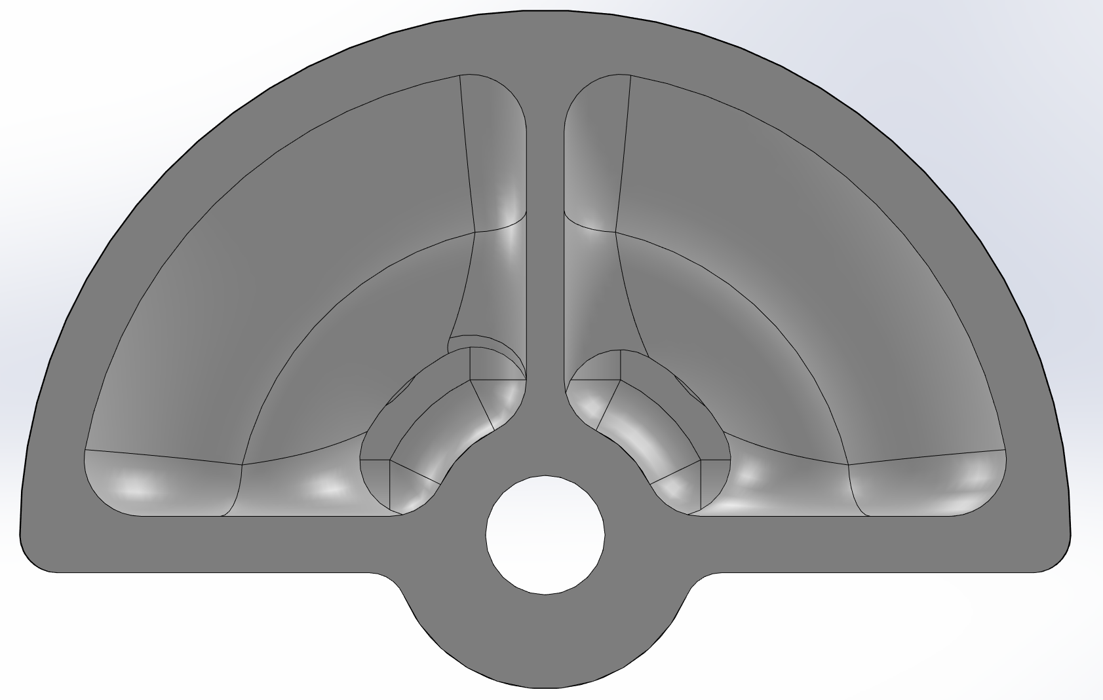
Torus Design

Slide 4
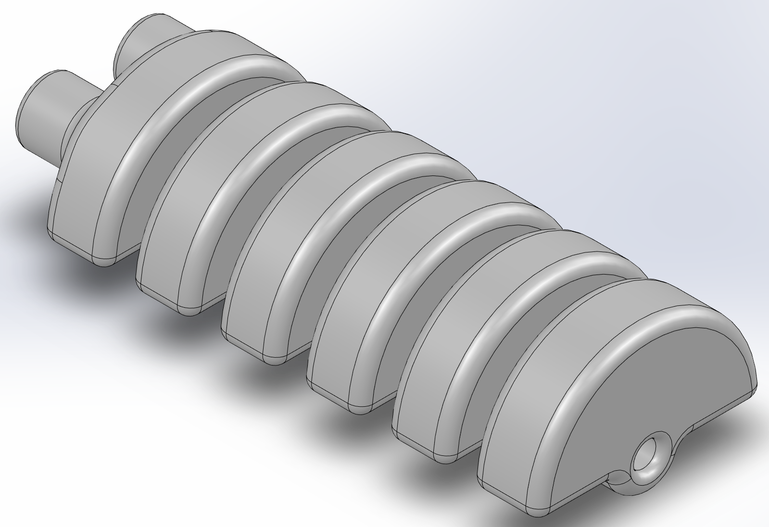
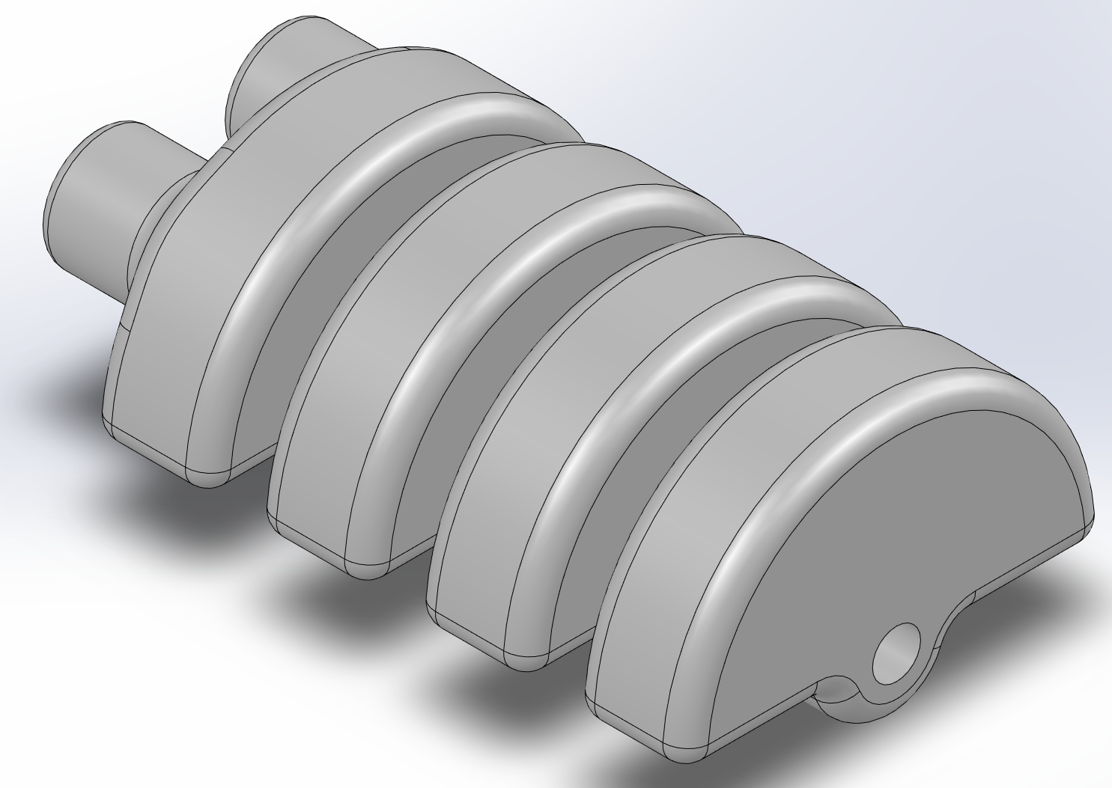
Larger Fillets

Slide 5
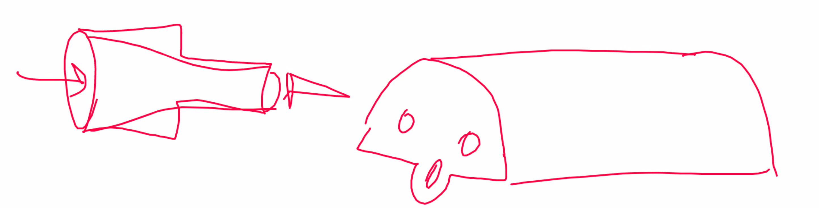
For Next Week
Design work
small diameter torus long and short
Reconcile rounds and send parts off for printing
Try to run water through the model
Need to make fitting for nozzle
Look at CFD fluid give this a few hours
Review Soft Robot Toolkits
Build Testing Rig
Review assembling and animating a 4 bar mechanism connected by revolute or prismatic joints
Helix with offset chamber and more space between layers
Hexagonal/Octagonal helix

